Slide 1
Image Super-Resolution using an Efficient Sub-Pixel CNN
Task: Face hallucination
Oksana Bolibok

Slide 2
Introduction
Super-resolution is a technique to enhance image quality by increasing resolution.
Our goal: Train an ESPCN model to upscale low-resolution images to high-resolution using the CelebA dataset.
CelebA dataset: Contains high-resolution celebrity face images.
Super-resolution has applications in image restoration and facial recognition.

Slide 3
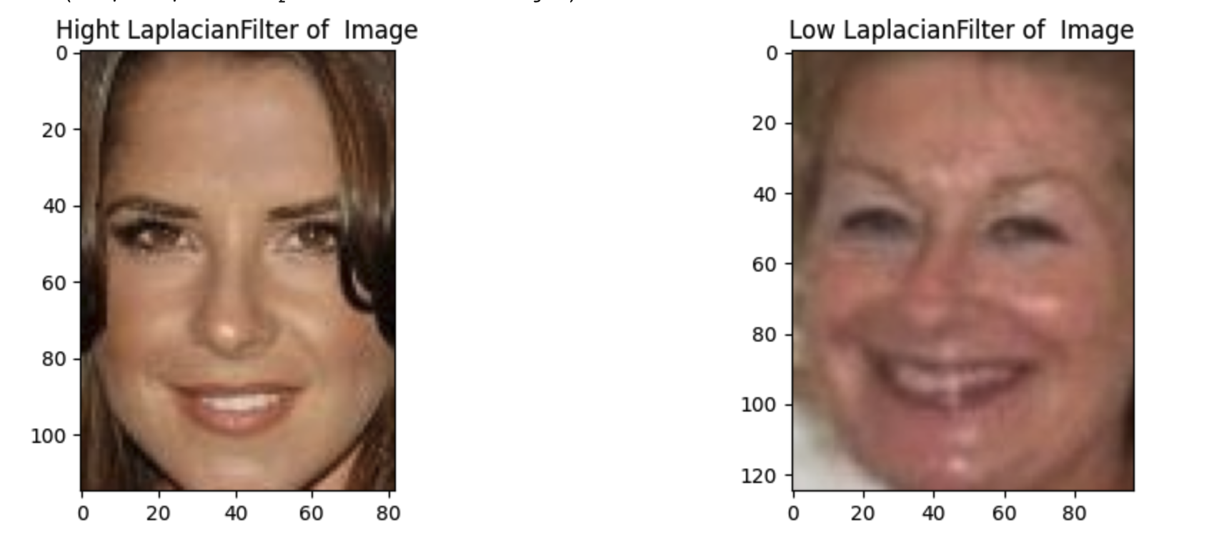
EDA
Data preprocessing steps on the CelebA dataset.
Pixel value scaling from (0, 255) to (0, 1) for normalization.
Determining photo sizes and image blur
Converting RGB images to YUV color space, extracting the Y channel for training.
Y channel resized to low-resolution input size (32x32).

Slide 4
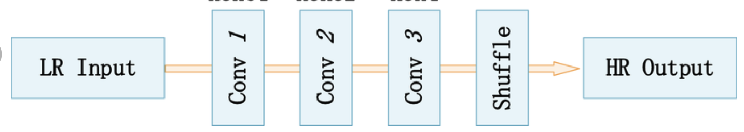
ESPCN Model Architecture
The Enhanced Super-Resolution Convolutional Network (ESPCN) architecture.
Designed for single-image super-resolution tasks.
Key components: Convolutional layers and Depth-to-Space layer for upscaling.
Conv2D layers capture image features and patterns.
Depth-to-Space layer upscales low-resolution input to high-resolution output.

Slide 5
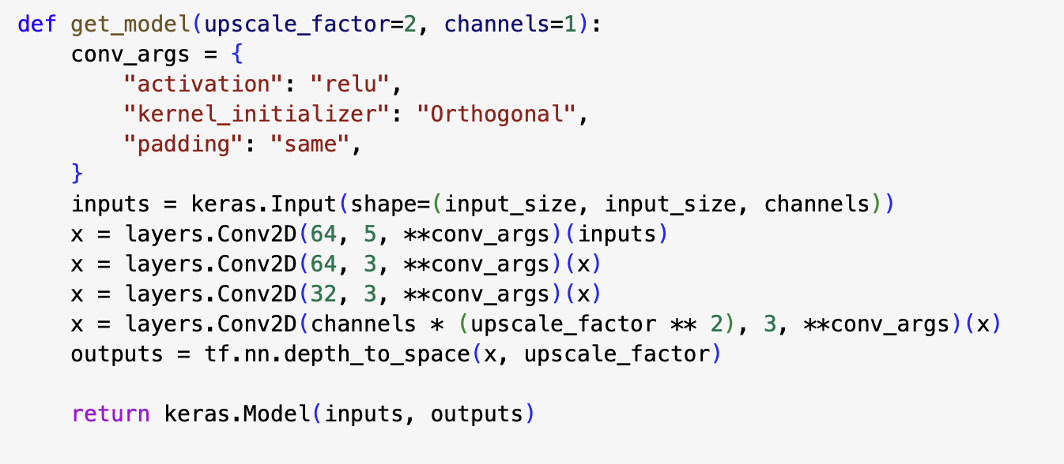
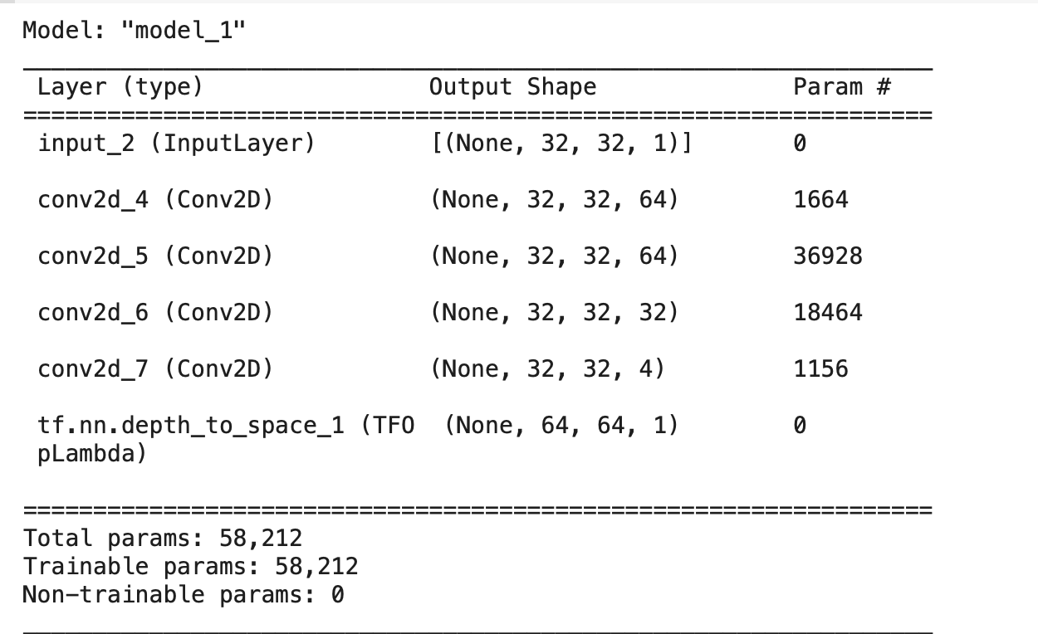
ESPCN Model Architecture

Slide 6
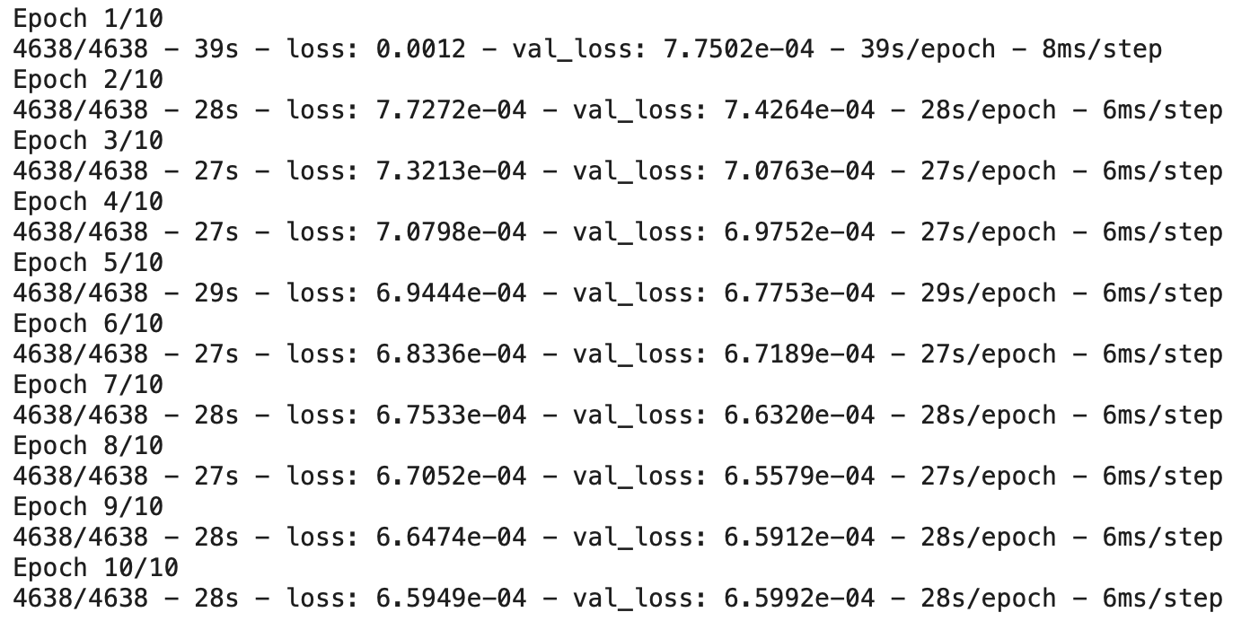
Training and Evaluation
ESPCN model training process (used 10 epoch) .
Adam optimizer with Mean Squared Error loss for training.

Slide 7

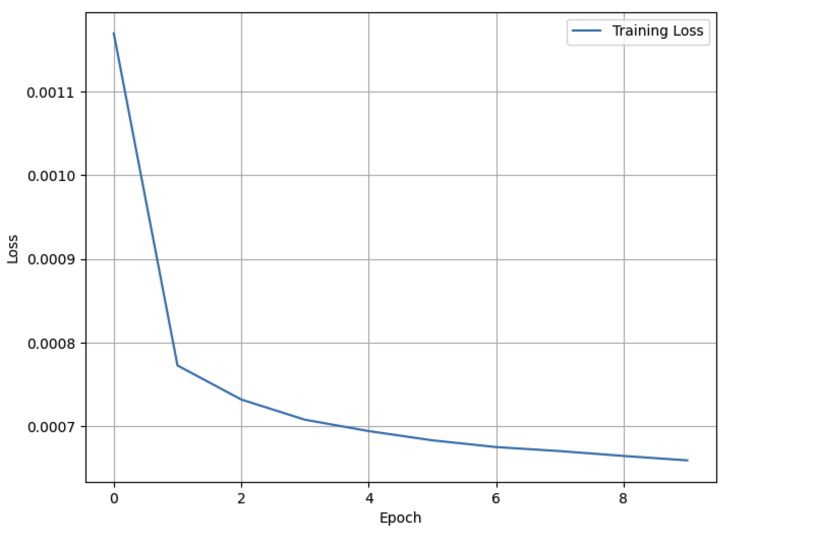
Training and Evaluation
loss: 6.5949e-04
val_loss: 6.5992e-04

Slide 8
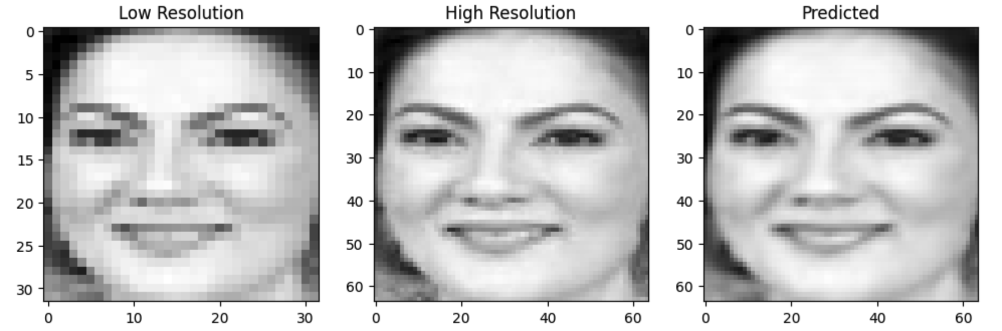
Results and Visualizations
Effectiveness of ESPCN in upscaling low-resolution to high-resolution.

